Slide 1

APACHE TEZ

Slide 2
INTRODUCTION
• Distributed execution framework targeted towards data-processing applications.
• Based on expressing a computation as a dataflow graph.
• Highly customizable to meet a broad spectrum of use cases.
• Built on top of YARN – the resource management framework for Hadoop.

Slide 3
TOPICS COVERED
HISTORY
INTRODUCTION
HADOOP 1.0 VS HADOOP 2.0
ARCHITECTURE
CHARACTERISTICS
TEZ API
DIFFERENCES
APPLICATION
PROCESSING MODEL
INSTALLATION (DOCUMENTATION)

Slide 4
HISTORY
Entered Apache Incubator in Feb 2013
Committers from various companies:
–> Hortonworks
–> Microsoft
–> Yahoo
–> LinkedIn
–> NASA JPL
–> Cloudera, Twitter, …
Graduated to a TLP in July 2014.

Slide 5
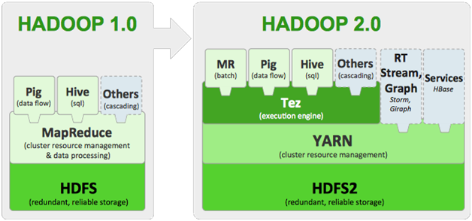
HADOOP 1.0 VS HADOOP 2.0

Slide 6
ARCHITECTURE
Vertex as data processor.
Edge connect vertices. There are several such properties of it :
The data-movement property defines how data moves from a producer to a consumer.
Scheduling properties (sequential or concurrent) helps us define when the producer and consumer tasks can be scheduled relative to each other.
Data-source property (persisted, reliable or ephemeral), defines the durability of the output produced by our task so that we can determine when we can terminate it.

Slide 7
CHARACTERISTICS
• Distributed parallel execution
• Negotiating resources from the Hadoop framework
• Fault tolerance and recovery
• Horizontal scalability
• Resource elasticity
• Shared library of ready-to-use components
• Built-in performance optimizations
• Security

Slide 8
TEZ - API
The API has three components:
DAG - this defines the overall job.
Vertex - this defines the user logic and the resources & environment needed to execute the user logic. One vertex correspnds to one step in the job. It represents application logic.
Edge - this defines the connection between producer and consumer vertices. This represents the movement of data among various vertices.

Slide 9
DAG ( directed acyclic graph)
The data processing is expressed in the form of a directed acyclic graph (DAG).
DAG is a graph of all steps needed to complete a job.
It has topological ordering, a sequence of vertices such that every edge is directed from earlier to later in sequence. It can model many different kind of information.
OR
it is a dataflow graph, with the vertices in the graph representing processing of data and edges representing movement of data between the processing.

Slide 10
MapReduce VS TEZ
MapReduce
Apache TEZ
MapReduce supports batch oriented queries.
MapReduce is available in all hadoop versions.
MapReduce always requires a map phase before the reduce phase .
Response time is slower due to the access of HDFS after every Map and Reduce phase.
Stores temporary data into HDFS after every map and reduce phase .
Apache Tez supports interactive queries.
Apache Tez is available in Apache Hadoop 2.0 and above.
A single Map phase and we may have multiple reduce phases .
Response time is high due to lesser job splitting and HDFS access.
Apache Tez doesn’t write data into HDFS, so it is more efficient .

Slide 11
SPARK VS TEZ
SPARK
TEZ
Spark can run as a standalone or on top of Hadoop YARN.
its containers need to keep running even when they aren’t processing any data.
Spark also offers Spark Streaming, Spark R, Machine Learning, and GraphX .
Tez can only run on top of YARN.
Tez containers, however, can shut down as soon as they are finished and release the resources.
Such functions are not offered by it.

Slide 12
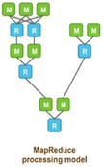
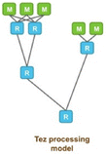
PROCESSING MODELS
MapReduce
Tez

Slide 13
INSTALLATION DOCUMENTATION
This is for Ubuntu user only…..
sudo apt-get install maven – to install maven
After installing Maven, check it by using the below command:--
mvn –version
Download the protobuff 2.5.0 and untar the file.
mv protobuf-2.5.0 $HOME/---to move the protobuf to home directory .

Slide 14
→ To configure protocol buffer..
./autogen.sh
./configure –prefix=/usr
make
make install
→To check the protocol buffers version
Protoc –version
→Now download the tar file for Apache Tez -0.8.2
→Untar the file
Tar –xvf apache-tez-0.8.2.tar.gz
→Move into the extracted tar folder..

Slide 15
Open the pom .xml site..
gedit pom.xml
Change the version of JAVA , PROTOCOL BUFFER and PIG (IF YOU WANT TO IMPLEMENT TEZ USING PIG)
Save the file and close it
→Now to bulid tez type the following command as it is:
mvn clean package –DskipTests
or
mvn clean package -DskipTests=true –Dmaven.javadoc.skip=true
-→Now, in the target directory of tez-dist you can see two tar balls are created:
tez-0.8.1-alpha.tar.gz && tez-0.8.1-alpha-minimal.tar.gz

Slide 16
→Create a tez folder in the home directory
mkdir tez
→Now, create a folder with name tez in your HDFS, using the below command:
hdfs dfs –mkdir /tez
→ Copy the tez-0.8.1-alpha.tar.gz tar ball into the directory using the below command:
hdfs dfs –put tez-0.8.2.tar.gs /tez
→You can check whether the file has copied to HDFS or not by using the below command:
hdfs dfs –ls /tez
→Now, within the tez folder, which is in your local file system, create two folders with name conf and tez using the below commands:
mkdir conf
mkdir tez

Slide 17
→Extract the contents of the file tez-0.8.1-alpha-minimal.tar.gz to the newly created tez folder
→Now, create a file tez-site.xml in your newly created conf directory and add the below configurations in the tez-site.xml file:
<configuration>
<property>
<name>tez.lib.uris</name>
<value>hdfs://localhost:9000/tez/tez-0.8.2.tar.gz</value>
</property>
</configuration>
→Now close and save the file. Your Tez is ready! You can now integrate it with Hadoop by adding the following properties in your hadoop-env.sh file of Hadoop.
export TEZ_CONF_DIR=/home/kiran/tez/conf/
export TEZ_JARS=/home/kiran/tez/tez/
export HADOOP_CLASSPATH=${TEZ_CONF_DIR}:${TEZ_JARS}/*:${TEZ_JARS}/lib/*:${HADOOP_CLASSPATH}:
${JAVA_JDBC_LIBS}:${MAPREDUCE_LIBS}
Note: You need to provide the conf directory folder path in the CONF_DIR and in the TEZ_JARS you need to give the untared tez-0.8.2-minimal.tar.gz folder.

Slide 18
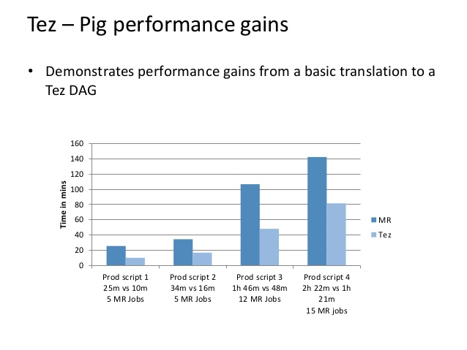
COMPARISON B/W MAPREDUCE AND TEZ USING GRAPH

Slide 19
THANKU

